Slide 1
UAF - Live Set

Slide 2
Defense: Delayed Free
Examine total size of blocks placed on free wait list since last scanning
Free Request
>= threshold?
Yes
Scanning (Policy)
No
Add block X to waiting list

Slide 3
IE Mitigation Problem
Value-based analysis
Mistake integer or floating point to pointer (memory address)/pointer cast to integer
bypass ASLR: Abusing Silent Mitigations, where’s my heap?
type-unsafe memory reuse
When pointer protection enable, miss pointer
pointer protection
Performance
scanning the heap/stack/register (conservative garbage collection)
Benign dangling pointer

Slide 4
Idea
Liveness analysis
Static analysis
find all liveness information and pointer type
instrumentation
Runtime
keep one liveness set
Think about source code and binary code

Slide 5
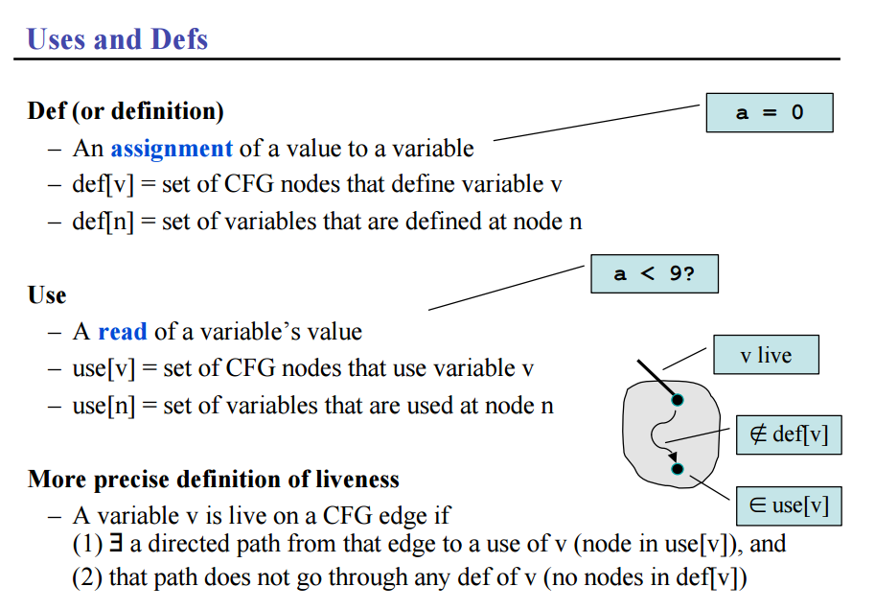
Liveness analysis
Liveness pass
Liveness def
Liveness pointer
Liveness for GC
Notes:
Fast Liveness Checking for SSA-Form Programs: http://www.rw.cdl.uni-saarland.de/~grund/papers/cgo08-liveness.pdf
Computing Liveness Sets for SSA-Form Programs:https://hal.inria.fr/inria-00558509v1/document
http://blog.csdn.net/dashuniuniu/article/details/50723930

Slide 6
Source Code
free(temp->next); // Free memory
printf("\nafter free: %x\n", *(temp->next));

Slide 7
LLVM liveness analysis
; %temp,
%54 = load %struct.Node** %temp, align 8
; %temp, %54,
%55 = getelementptr inbounds %struct.Node* %54, i32 0, i32 1
; %temp, %55,
%56 = load %struct.Node** %55, align 8
; %temp, %56,
%57 = bitcast %struct.Node* %56 to i8*
; %temp, %57,
call void @free(i8* %57) #3
; %temp,
%58 = load %struct.Node** %temp, align 8
; %58,
%59 = getelementptr inbounds %struct.Node* %58, i32 0, i32 1
; %59,
%60 = load %struct.Node** %59, align 8
; %60,
%61 = call i32 (i8*, ...)* @printf(i8* getelementptr inbounds ([17 x i8]* @.str1, i32 0, i32 0), %struct.Node* %60)

Slide 8
Assembly code
.text:000000000040074B mov rax, [rbp+temp]
.text:000000000040074F mov rax, [rax+8]
.text:0000000000400753 mov rdi, rax ; ptr
.text:0000000000400756 call _free
.text:000000000040075B mov rax, [rbp+temp]
.text:000000000040075F mov rax, [rax+8]
.text:0000000000400763 mov rsi, rax
.text:0000000000400766 mov edi, offset aAfterFreeP ; "\nafter free: %p\n"
.text:000000000040076B mov eax, 0
.text:0000000000400770 call _printf

Slide 9
Build Scan Policy
Liveness analysis
regular compiler liveness analysis result
If there are any data structure type, we need to compare with related malloc set
Build unique set for each heap memory allocation (e.g. malloc)
static taint analysis for each malloc’s return value
set life cycle for each variable in each unique set
function return, different stack frame
maintain one list [(memory object, memory location),]
figure out the efficient data structure for each malloc set
easy to update
maintain the relationship for each malloc set
IR special feature (all access is based on the base pointer)
Store A[(memory location, ptr, base pointer), (memory location, ptr, base pointer)]
Static analysis and Dynamic analysis

Slide 10
Basic story
struct ptr{
int integer;
struct ptr * p;
}
Liveness Analysis
Live Set {a (struct ptr *), b (int *), c (char), d (char*), e (long)}
Heap tracker generates unique set for each memory object:
maintain relationship
update(add or remove)
pointer expression:
static defined data structure, and dynamic allocation data structure (linked list, tree, graph..)

Slide 11
Data structure
Live Set [(Mem addr, ptr value, type), (Mem addr, ptr value, type) ...]
Memory object reference list:
[(Mem addr, ptr value, base ptr), (Mem addr, ptr value, base ptr) ...]
How to find the base ptr??
How to build the relationship???
Update list: [(Mem obj, Mem addr), (Mem obj, Mem addr) ...]
Update (stack & heap)

Slide 12
Basic example
struct ptr{
int integer;
int *p;
};
int main()
{
int *ptr_one;
ptr_one = (int *)malloc(sizeof(int));
if (ptr_one == 0)
{
printf("ERROR: Out of memory\n");
return 1;
}
*ptr_one = 25;
struct ptr *temp = (struct ptr *) malloc (sizeof(struct ptr));
temp->integer = *ptr_one;
temp->p = ptr_one;
printf("%d\n", *ptr_one);
free(ptr_one);
printf("%d\n", temp->p);
free(temp);
return 0;
}

Slide 13
Liveness Result
; %1, %ptr_one, %temp,
%10 = call noalias i8* @malloc(i64 16) #3
; %1, %ptr_one, %temp, %10,
%11 = bitcast i8* %10 to %struct.ptr*
; %1, %ptr_one, %temp, %11,
store %struct.ptr* %11, %struct.ptr** %temp, align 8
; %1, %ptr_one, %temp,
%12 = load i32** %ptr_one, align 8
; %1, %ptr_one, %temp, %12,
%13 = load i32* %12, align 4
; %1, %ptr_one, %temp, %13,
%14 = load %struct.ptr** %temp, align 8
; %1, %ptr_one, %temp, %13, %14,
%15 = getelementptr inbounds %struct.ptr* %14, i32 0, i32 0
; %1, %ptr_one, %temp, %13, %15,
store i32 %13, i32* %15, align 4
; %1, %ptr_one, %temp,
%16 = load i32** %ptr_one, align 8
; %1, %ptr_one, %temp, %16,
%17 = load %struct.ptr** %temp, align 8
; %1, %ptr_one, %temp, %16, %17,
%18 = getelementptr inbounds %struct.ptr* %17, i32 0, i32 1
; %1, %ptr_one, %temp, %16, %18,
store i32* %16, i32** %18, align 8
; %1, %ptr_one, %temp,
%19 = load i32** %ptr_one, align 8
; %1, %ptr_one, %temp, %19,
%20 = load i32* %19, align 4
; %1, %ptr_one, %temp, %20,
%21 = call i32 (i8*, ...)* @printf(i8* getelementptr inbounds ([4 x i8]* @.str1, i32 0, i32 0), i32 %20)
; %1, %ptr_one, %temp,
%22 = load i32** %ptr_one, align 8
; %1, %temp, %22,
%23 = bitcast i32* %22 to i8*
; %1, %temp, %23,
call void @free(i8* %23) #3
; %1, %temp,
%24 = load %struct.ptr** %temp, align 8
; %1, %temp, %24,
%25 = getelementptr inbounds %struct.ptr* %24, i32 0, i32 1
; %1, %temp, %25,
%26 = load i32** %25, align 8
; %1, %temp, %26,
%27 = load i32* %26, align 4
; %1, %temp, %27,
%28 = call i32 (i8*, ...)* @printf(i8* getelementptr inbounds ([4 x i8]* @.str1, i32 0, i32 0), i32 %27)

Slide 14
Linked list source code
void push(struct Node** head_ref, int new_data)
{
struct Node* new_node = (struct Node*) malloc(sizeof(struct Node));
new_node->data = new_data;
new_node->next = (*head_ref);
(*head_ref) = new_node;
}
/* Start with the empty list */
struct Node* head = NULL;
push(&head, 7);
push(&head, 1);
push(&head, 3);
push(&head, 2);
push(&head, 8);

Slide 15
Liveness Result
; Function Attrs: nounwind uwtable
define void @push(%struct.Node** %head_ref, i32 %new_data) #0 {
; %head_ref, %new_data,
; %head_ref, %new_data,
%1 = alloca %struct.Node**, align 8
; %head_ref, %new_data, %1,
%2 = alloca i32, align 4
; %head_ref, %new_data, %1, %2,
%new_node = alloca %struct.Node*, align 8
; %head_ref, %new_data, %1, %2, %new_node,
store %struct.Node** %head_ref, %struct.Node*** %1, align 8
; %new_data, %1, %2, %new_node,
store i32 %new_data, i32* %2, align 4
; %1, %2, %new_node,
%3 = call noalias i8* @malloc(i64 16) #3
; %1, %2, %new_node, %3,
%4 = bitcast i8* %3 to %struct.Node*
; %1, %2, %new_node, %4,
store %struct.Node* %4, %struct.Node** %new_node, align 8
; %1, %2, %new_node,
%5 = load i32* %2, align 4
; %1, %new_node, %5,
%6 = load %struct.Node** %new_node, align 8
; %1, %new_node, %5, %6,
%7 = getelementptr inbounds %struct.Node* %6, i32 0, i32 0
; %1, %new_node, %5, %7,
store i32 %5, i32* %7, align 4
; %1, %new_node,
%8 = load %struct.Node*** %1, align 8
; %1, %new_node, %8,
%9 = load %struct.Node** %8, align 8
; %1, %new_node, %9,
%10 = load %struct.Node** %new_node, align 8
; %1, %new_node, %9, %10,
%11 = getelementptr inbounds %struct.Node* %10, i32 0, i32 1
; %1, %new_node, %9, %11,
store %struct.Node* %9, %struct.Node** %11, align 8
; %1, %new_node,
%12 = load %struct.Node** %new_node, align 8
; %1, %12,
%13 = load %struct.Node*** %1, align 8
; %12, %13,
store %struct.Node* %12, %struct.Node** %13, align 8
;
ret void
}

Slide 16
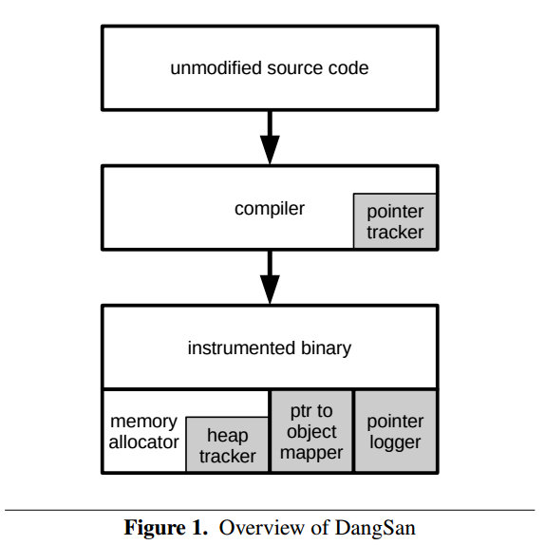
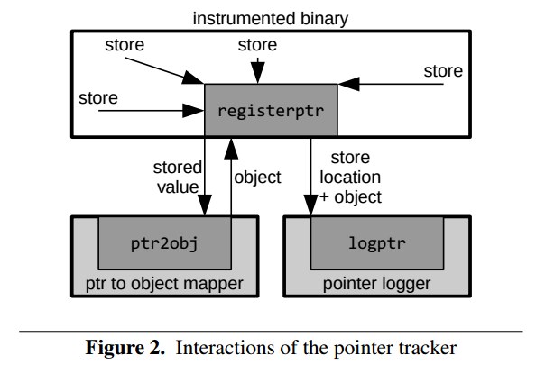
DangSan: Scalable Use-after-free Detection (EuroSys 17)

Slide 17
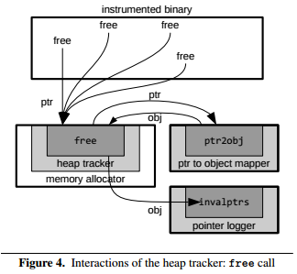
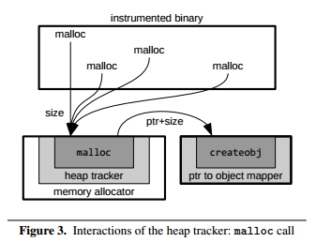
DangSan: Scalable Use-after-free Detection (EuroSys 17)

